Slide 1

FLEX BOX Properties
BY : Anjali Sharma

Slide 2

Let’s check yesterday’s coding practice

Slide 3
Sizing Element :
Intrinsic Size : Some elements have a natural size set by default, we call it Intrinsic Size.
Extrinsic Size : if we set a Specific Size to an element, we call an Extrinsic Size.

Slide 4
CSS Overflow Property :
(Content overflow handled using the CSS overflow property.)
overflow : visible (default) - CSS tries to avoid data loss.
overflow : hidden - The overflow is clipped, and the rest of the content will be invisible.
overflow : scroll- The overflow is clipped, and a scrollbar is added to see the rest of the content.
Overflow : auto - It is similar to scroll, but it adds scrollbars only when necessary.
overflow-x - To handle overflow in the horizontal direction.
overflow-y - To handle overflow in the vertical direction.

Slide 5
Min & Max Sizes
min-height & min-width CSS properties can be used to define the minimum sizes of an element.
Example :
max-height & max-width CSS properties can be used to restrict the sizes of an element.
Example :
.paragraph {
border: 2px solid blue;
width: 150px;
min-height: 150px;
max-height: 180px;
overflow: auto;
}

Slide 6
Layout
A Layout is a pattern to structure the information and arrange the elements on the website.
Mainly, there are two methods that help design the webpage layout.
Flexbox (stable) : →
Flexbox is a layout method that helps to arrange the HTML elements in rows (horizontally) or columns (vertically).
CSS Grid (Advanced & Fast growing but not stable) : →
The Grid Layout Module offers a grid-based layout system, with rows and columns.

Slide 7
Display : flex
Providing display property with the value flex converts the element into a Flex Container.
All HTML elements that are direct children of Flex Container are called Flex Items.
Flex Direction : -
The Flex Direction specifies the direction of the flex items in the Flexbox Container.
When working with Flexbox , think in terms of two axes.
Main Axis- It is specified by the flex-direction property.
Cross Axis- It runs perpendicular to the main axis.
Flex Direction values:
flex-direction : row - Direction of the flex items is horizontal.
flex-direction : column - Direction of the flex items is vertical.

Slide 8
justify-content
( specifies the alignment of flex items along the main axis. )
Justify Content values:
flex-start (default) - All the elements will arrange to the start of the container.
center - All the elements will arrange to the center of the container.
flex-end - All the elements will arange to the end of the container.
space-between - Left over space will be arranged in between the flex items.
space-around - Every flex item will get space around them.

Slide 9
align-item
(The align-items property specifies the alignment of flex items along the cross axis.)
Align item values:
Stretch (default)- Will stretch its available height.
flex-start - Will be at the starting of the flex container.
Center - Will be at the center of the avilable height.
flex-end - Will be at the ending point of the available height.

Slide 10
flex-wrap : →
( property arranges the flex items in multiple lines. )
Flex Wrap property values:
nowrap (default)
wrap
wrap-reverse and many more...
align-self : →
(specifies the alignment of Individual Flex Items along the cross axis . )
Align Self property values:
flex-start
center
flex-end
stretch
Auto (default) { value of its Flex Container gets inherited. } and more...

Slide 11
Coding Practice
Create a responsive Netflix Plan Selection section using Flexbox. Include 3 plans: Mobile, Standard, and Premium. Use clean layout, pricing info, and bold buttons to mimic Netflix UI.
Plan name (e.g., “Mobile”, “Standard”, “Premium”)
Price (e.g., ₹149/month)
Features: video quality, resolution, devices
A "Subscribe" button
Use Flexbox to align and space cards
Add min-width, max-width, min-height
Try to explore shadow , hover ….

Slide 12
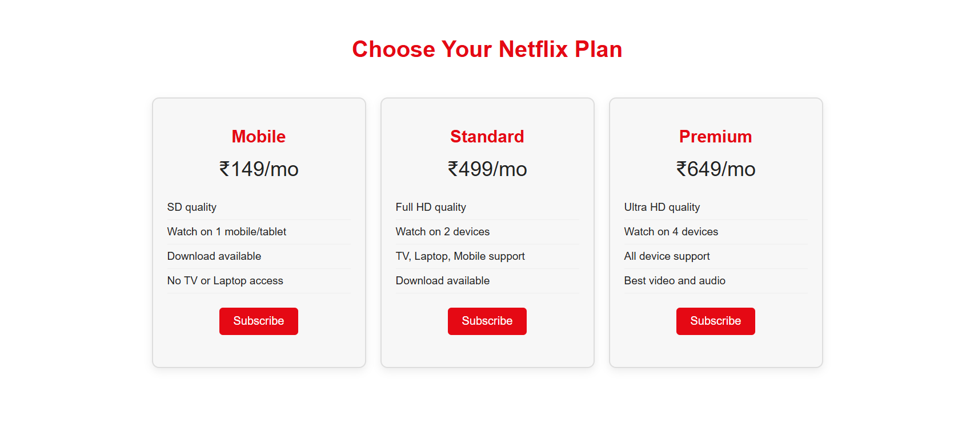

Slide 13

Sizing Element
CSS overflow property
Max & min size
Layout
Display property
flex-direction
Align-item
Justify-content
Flex-wrap
Align-self
Coding practice

Slide 14
THANK YOU
All the best !!!

